Slide 1
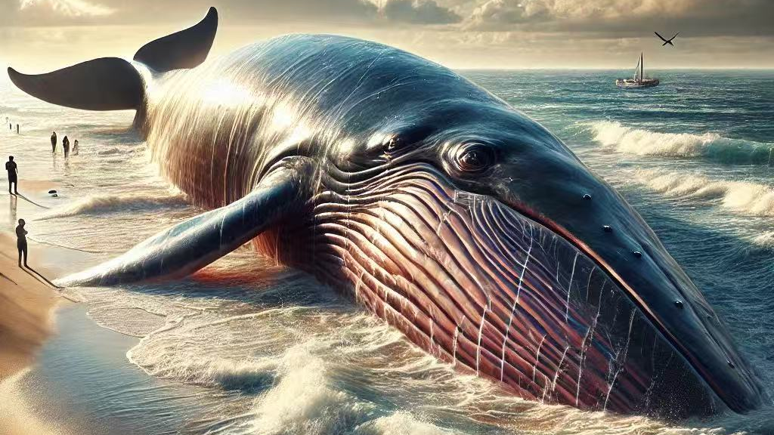
Whale mass stranding
Amanda li
Ets1
8896264

Slide 2
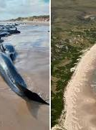
Background and Key Concepts
Cause a lot of issue
Complex conditions, impossible to save them
Euthanise, stranded on a remote beach
Let nature run its course

Slide 3
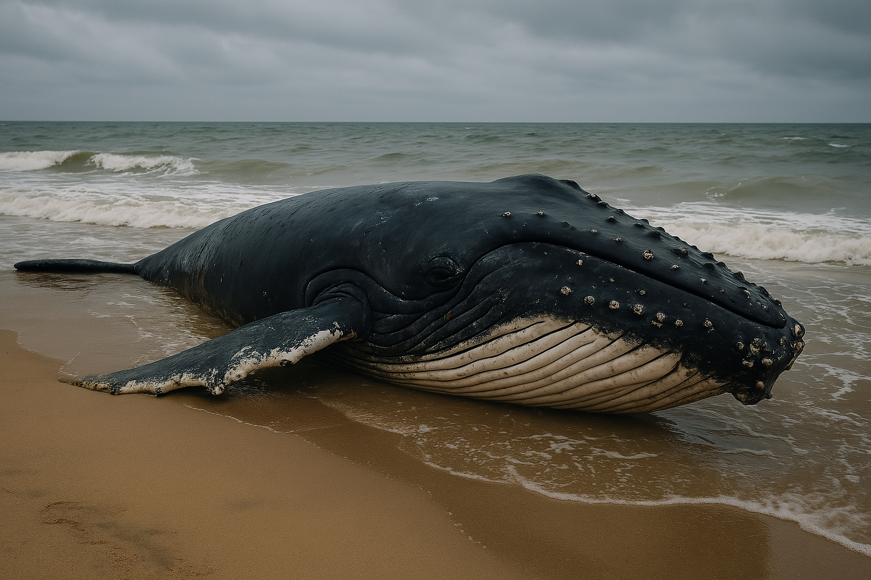
The source of the news article
Title: scores of whales to be euthanised after mass stranding Australia
Author : Tiffanie Turnbull BBC news sydney 19 February 2025
Source url: https://www.bbc.com/news/articles/cd7e38py4geo

Slide 4
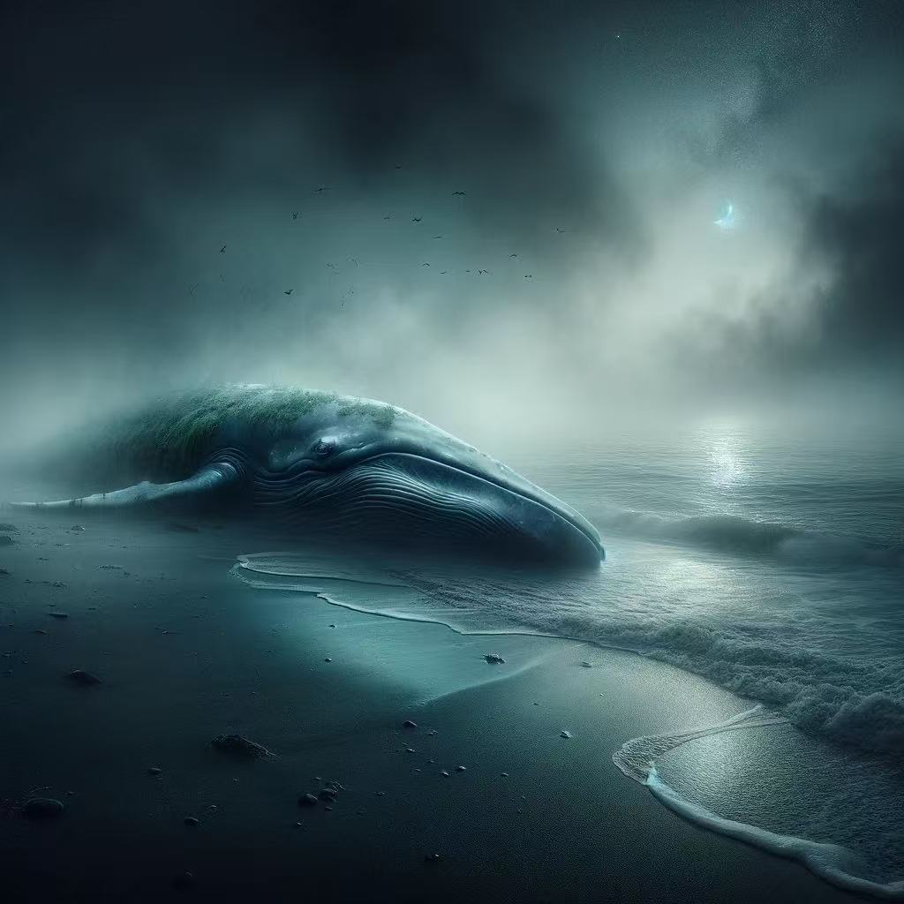
Background and key concepts
The source of the news article
The key ideas in the article
The author's opinion
My response
Recommendations
Conclusion
Questions and Discussion

Slide 5
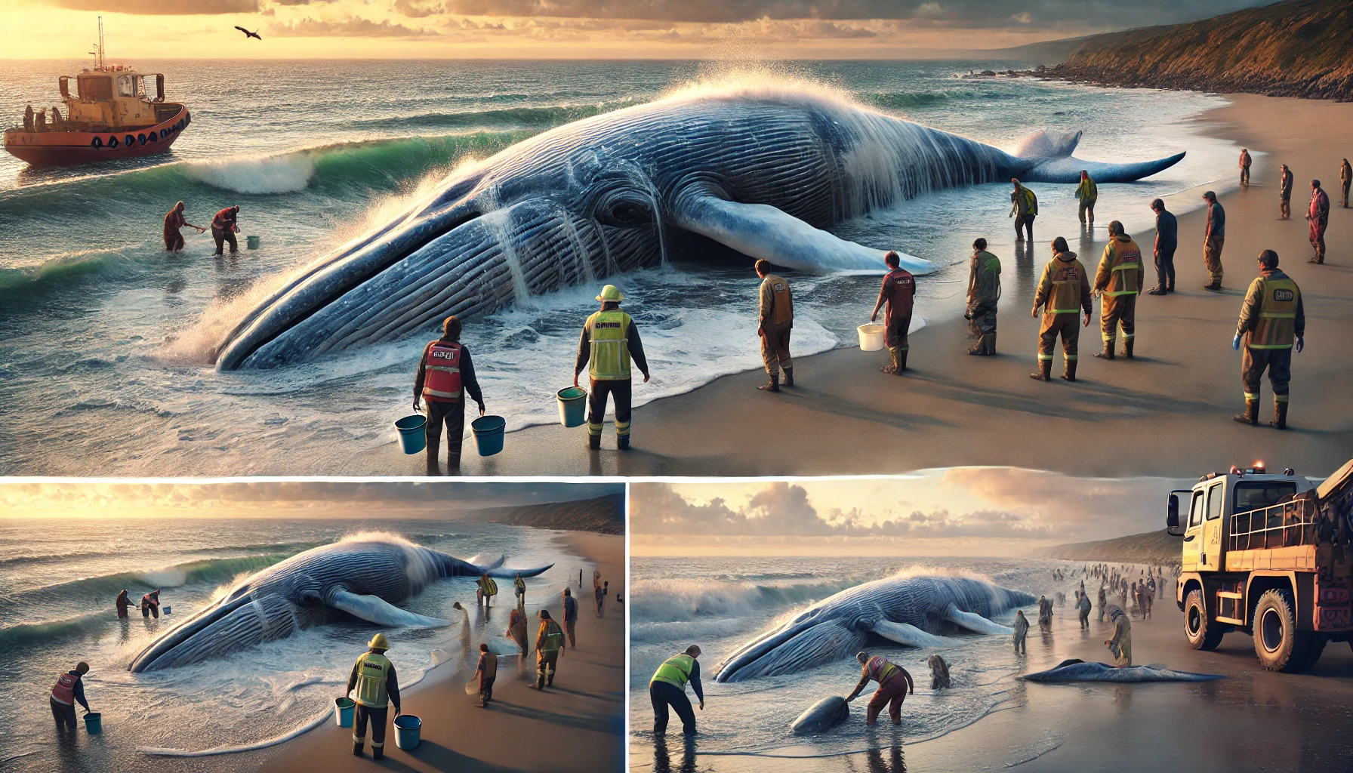
The key ideas in the article
Challenges of rescue face
Why whale strandings happen

Slide 6
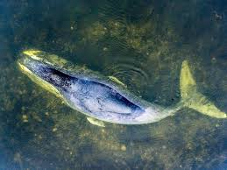
The author's opinion
Respect and compassion for whale life.
Comprehension of saving the whales.
Helplessness in the face of whale mass strandings.
It is adopted from chatgpt

Slide 7
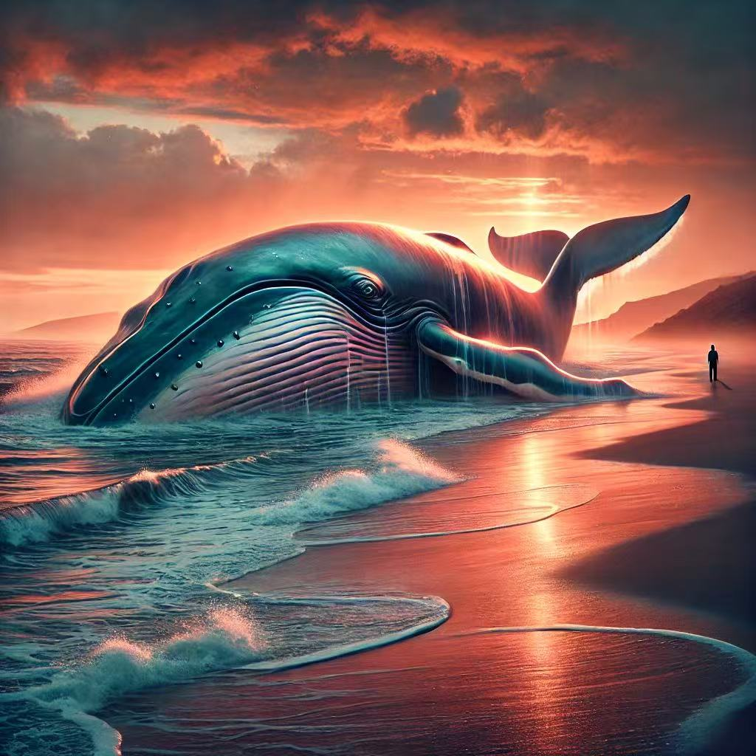
My response
Whale mass stranding is an alarming ecological issue
Encourage scientific study promote effective protection. rescue measures

Slide 8
Recommendations
Environmental Protection:
Reduce plastic use and clean ocean waste.
Prevent industrial wastewater seeping into the ocean.
Volunteer Involvement:
Help to clean
Public Awareness:
Promote civic responsibility through schools, communities, and media
Protect environment

Slide 9
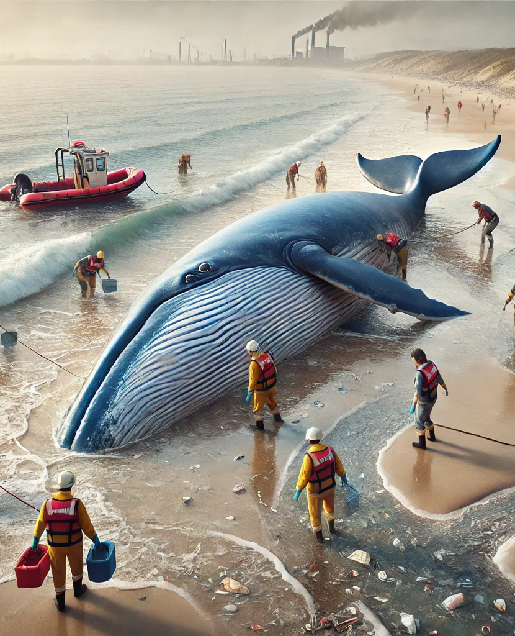
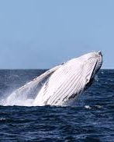
Conclusion
Enhance scientific research
Promote effective protection
Rescue measures
Raisie public awareness
Promote global cooperation
Protect ecosystem

Slide 10
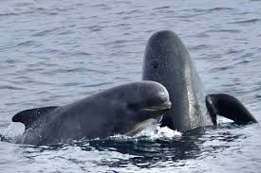
Question

Slide 11
The generative Al tool was accessed on 30 March 2025 to assist with this assessment
The prompt, "Please help me to generate a picture of whale mass stranding', was used to develop graphics.

